Slide 1
Chapter 22

Slide 2
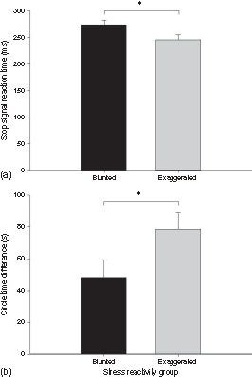
Figure 1 Mean (SE) (a) stop signal reaction time, and (b) circle time difference for the deficient and exaggerated stress reactivity groups, *p ≤ 0.05. Deficient stress reactors show greater impulsivity.

Slide 3
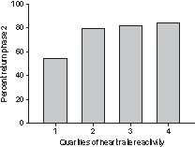
Figure 2 Percentage study completion rate by quartiles of heart rate reactivity. The quartile with the smallest heart rate reactions were significantly less likely to complete the study.

Slide 4
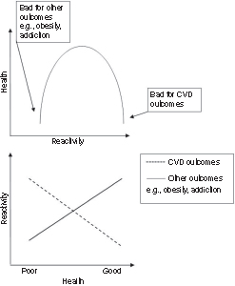
Figure 3 Alternative models, inverted-U and distinct mechanisms, linking stress reactivity to health and behavioral outcomes.

Slide 5
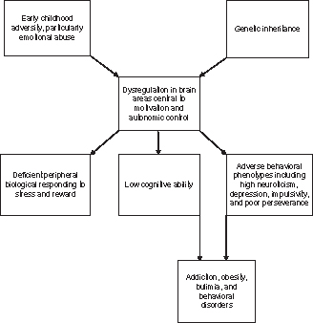
Figure 4 Provisional model of deficient biological stress reactivity; from this perspective, deficient reactivity is regarded as a marker rather than a cause of endpoint behavioral and health outcomes.

